Slide 1
Leadership in Business and Society
BUSN 3052
Influencing: Power, Politics, Networking, and Negotiation
Lecture 4
Material largely drawn from: Lussier, RN & Achua, CF 2016 Leadership: theory, application and skill development, 6th edition, Cengage Learning, Boston.

Slide 2
Learning Outcomes
Explain the differences between position power and personal power.
Identify different types of power and appropriate influencing tactics.
Discuss how power and politics are related.
Identify the importance of networking.
Describe the steps in the negotiation process.

Slide 3

Power
Power is the leader’s potential influence over followers.
  Power is the potential to influence, not the actual use of power.
  Often the perception of power influences others.
  Leaders apply power through influence tactics.

Slide 4
Sources of power
Two sources of power:
  Position (hard) power
    Stems from a person’s position of authority
    derived from top management and delegated down the chain of command
    E.g., supervisor influences subordinates with rewards and punishments, manager issues orders
  Personal (soft) power
    Based on personal characteristics and interpersonal relationships
    derived from the followers based on the leader’s behaviour.
    Nonmanagers can have personal power but only managers can have position power.
    Successful leaders share power (empowerment) by pushing power down the chain of command.

Slide 5
Types of power
Legitimate
Coercive
Reward
Referent
Expert
Information
Connection

Slide 6
Influencing tactics
People use influence tactics to translate their power to affect the behaviour of others.
Influence tactics will increase the likelihood of favourable responses.
These must be matched to the situation and to the person being influenced.
Can be learned.

Slide 7
Types of influencing tactics
Legitimate
Rational persuasion
Consultation
Ingratiation
Exchange
Pressure
Personal appeal
Inspirational appeal
Coalition

Slide 8
Legitimate power
Legitimate power is based on the user’s position power, given by the organisation.
  Appropriate use of legitimate power:
    When asking people to do something that is within the scope of their job.
    Helpful to use the consultation influencing tactic.
      Seek others’ input about achieving an objective and open to develop plans together.
      Also known as participative management and empowering employees.

Slide 9
Rational persuasion influencing tactic
  Uses logical arguments with factual evidence to persuade others
  Develop a persuasive case based on the other party’s needs
  Useful when meeting objectives through employees or dealing with higher-level managers over whom they have no authority.
When persuading others to do something for us, the ingratiation influencing tactic is helpful:
  Give praise before asking for what you want.

Slide 10
Guidelines for a rational persuasion
Explain why objective needs met.
Explain how meeting the objective benefits the other party.
Provide evidence the objective can be met.
Explain how problems or concerns will be handled.

Slide 11
Increasing legitimate power
Guidelines for increasing legitimate power:
  Increase management experience,
    Could be part of the job such as team leader.
  Exercise authority regularly,
    Follow up making sure objectives are met.
  Follow rational persuasion guidelines,
    Especially when authority is questioned.
  Back up your authority with rewards and punishment.

Slide 12
Reward power
Reward power is based on the user’s ability to influence others with something of value to them.
  Use positive reinforcement to influence behaviour with incentives such as praise, recognition, pay rise, bonuses, promotions, etc.
  A leader’s power is strong or weak based on ability to punish and reward followers.
  An important part of reward power is having control over getting and allocating resources.

Slide 13
Appropriate use of reward power
Employees should be rewarded for doing a good job.
Exchange influencing tactic is helpful when dealing with others over whom they have no authority.
  Offer a reward for helping meet objective.
  Incentive can be anything of value (e.g., information, advice, assistance).

Slide 14
Guidelines for increasing reward power
Gain
Gain/maintain control over evaluating performance, determining raises, promotions and other rewards.
Find
Find out what others value and reward people in that way.
Let
Let people know you control rewards and state your criteria for giving rewards.

Slide 15
Coercive power
The use of coercive power involves punishment and withholding of rewards to influence compliance.
  Also called the pressure influencing tactic.
Appropriate use of coercive power:
  Coercive power is appropriate to use in maintaining discipline and enforcing rules.
  Employees resent use of coercive power.

Slide 16
Increasing coercive power
Guidelines for increasing coercive power:
  Gain authority to use punishment and withhold rewards,
  Don’t make rash threats,
    Do not use coercion to manipulate others or to gain personal benefits.
  Be persistent,
    Follow up to make sure requested tasks are accomplished.

Slide 17
Referent power
Referent power is based on the user’s personal relationships with others.
  Also called the personal appeals influencing tactic.
    Power stems mainly from relationships with the person using power.
    Based on loyalty and friendship.
Leaders can use the inspirational appeals influencing tactic.
  Leader appeals to follower’s values, ideals, and aspirations, or increases self-confidence by appealing to follower’s emotions and enthusiasm.
Used well with people whose behaviour is mostly influenced by emotions

Slide 18
Referent power
Appropriate Use
Appropriate for people with weak or no position power.
Such as with peers or in self-managed teams.
Increasing
Develop your people skills.
Work at your relationships with managers and peers.

Slide 19
Expert power
Expert power is based on the user’s skill and knowledge.
  Often use rational persuasion influencing tactic.
Power increases if only fewer people possess the expertise and knowledge.

Slide 20
Increasing expert power
Guidelines for increasing expert power:
  Increase training to become an expert,
  Attend trade meetings, read publications, keep up with current trends, write articles, become an officer in the organisation,
  Keep up with latest technology,
    Volunteer to learn something new,
  Project a positive self-concept and develop a reputation for having expertise.

Slide 21
Information power
Information power is based on the user’s data desired by others.
  Involves access to vital information and knowledge and control over its distribution.
Appropriate use of information power:
  When making rational persuasion or inspirational appeals.

Slide 22
Connection power
Connection power is based on the user’s relationships with influential people.
  Right connections give power or the perception of having power.
  Leaders use a coalition influencing tactic when persuading others – a political strategy.
  If more people are on your side, the more influence you have on others.
Appropriate use of connection power:
  When looking for a job or a promotion.
  Can help you get the resources you need.

Slide 23
Increasing connection power
Guidelines to increasing connection power:
  Expand your network to managers with power,
  Join the “in-crowd” and “right” associations,
  Follow guidelines for using the coalition influencing tactic,
  Get people to know your name,
    Get all the publicity you can,
    Have your accomplishments known by those in power.

Slide 24
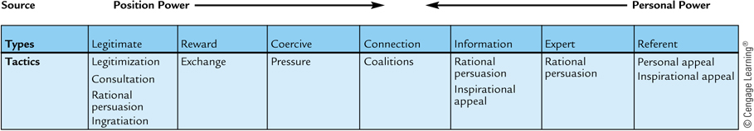
Sources and types of power with influencing tactics

Slide 25
Influence tactics by influence direction
Upward influence | Downward influence | Lateral influence
Rational persuasion | Rational persuasion | Rational persuasion
 | Inspirational appeals | Consultation
 | Pressure | Ingratiation
 | Consultation | Exchange
 | Ingratiation | Legitimacy
 | Exchange | Personal appeals
 | Legitimacy | Coalitions

Slide 26
The nature of organisational politics
Politics is the process of gaining and using power
  Power and politics are related.
  Involves activities to acquire, develop and use power and other resources to achieve desired goals when there are uncertainty or disagreement about choices.
  Political skills are needed to climb the corporate ladder.
Politics is a social medium of exchange.
  Politics is neither good nor bad.
    Simply a system of getting what you want.
  Politics is the medium of exchange in organisations.
  Political behaviour creates energy and commitment.

Slide 27
Political behaviour
How well you play politics affects the success.
Consist of activities outside the job requirements but that influence or attempt to influence the distribution of advantages and disadvantages within the organisation.
Organisational political behaviours:
  Networking
  Reciprocity
  Coalitions

Slide 28
Networking is the process of developing relationships for the purpose of socialising and politicking.
Reciprocity involves creating obligations and developing alliances, and using them to accomplish objectives.
Using coalitions as an influencing tactic:
  Developed for a specific objective
  Each party helps the others get what they want
  Use co-optation to get a person to join your coalition rather than compete against you.

Slide 29
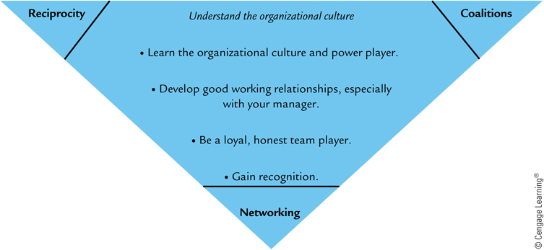
Political behavior and guidelines for developing political skills

Slide 30
Networking
Networking is part of politics.
Helps to develop power and influence others.
Social networking is also important.

Slide 31
Negotiation
Negotiating is a process in which two or more parties have something the other wants and attempt to come to an agreement.
  An essential career skill.
  Directly affects your success.
    Good negotiators get more favourable outcomes.
  Influencing tactics, power and politics used often in negotiation process.
  Getting what we want by influencing others through negotiation.

Slide 32
Negotiation
Negotiations are appropriate in all situations without a fixed price or deal.
      E.g., collective bargaining, buying and selling, etc.
  All parties should believe they got a good deal.
    Negotiation does not have to be a zero-sum game.
    Negotiation is about building relationships.
    Negotiation should be viewed by all parties as an opportunity to win.
  Negotiation skills can be developed by following the steps in the negotiation process.

Slide 33
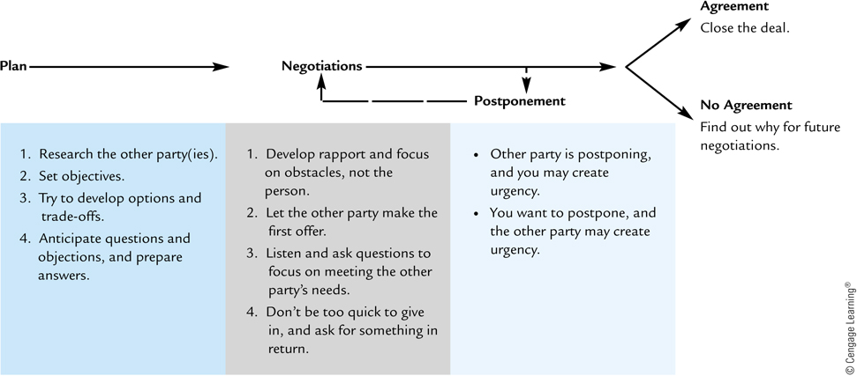
The negotiation process
The key is preparation.
Face-to face is preferred.
Know what is being negotiated.
Agreement?
Put it in writing
and stop selling.
No Agreement?
Analyse and improve for the future.
Take your time.
If no progress, postpone.

Slide 34
Summary
  Power is the leaders’ potential to influence over followers, not the actual use of power
  Power can be stemmed from the position or personal characteristics and interpersonal relationships
  Legitimate, reward and coercive power
  Referent, expert, information and connection power
  Influencing tactics help to exercise power
  Politics is the process of gaining and using power
  Networking is part of politics
  The ability to negotiate is important

